Slide 1
VOLTAGE DOUBLER CIRCUIT

Slide 2
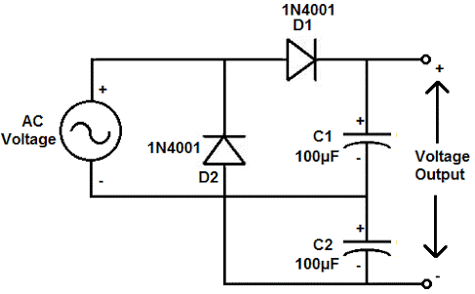
A voltage doubler circuit outputs a DC voltage that is double the peak value of the AC input voltage, without using a transformer.

Slide 3
Here two capacitors are simultaneously charged to the same voltage in parallel. The supply is then switched off and the capacitors are switched into series. The output is taken from across the two capacitors in series resulting in an output double the supply voltage.

Slide 4
Voltage Doubler
A voltage doubler is an electronic circuit that produces an output voltage that is double the input voltage. It is a voltage multiplier with a voltage multiplication factor equal to 2. The circuit is formed by an oscillating AC input voltage, two capacitors, and two diodes. The input voltage is AC, and the output is DC voltage with twice the peak value of the input AC voltage. When a load is connected across the output terminals, the output voltage (V_{out}) may be less than 2V_{S MAX}.

Slide 5
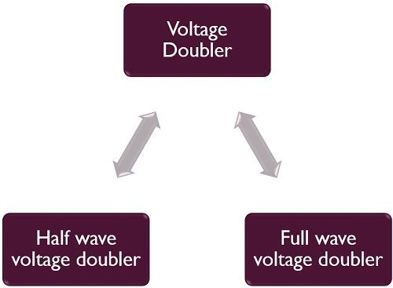
Voltage doubler circuits are mainly characterized as:

Slide 6
Voltage Doubler
In this doubler, right through the positive cycle of input AC voltage, the first diode (D₁) is in the conducting state.
That is a forward biased state, and it will charge the connected capacitor (C₁) equal to the peak value of AC secondary voltage of transformer (V_{SMAX}).
At this time, D₂ will be in reverse biased condition or non-conducting state. Throughout the negative cycle of input AC voltage, the second diode (D₂) will be in forwarding biased state, and the second capacitor (C₂) gets charged.
In the no-load condition, the entire voltages of two capacitors are delivered as the output voltage.

Slide 7
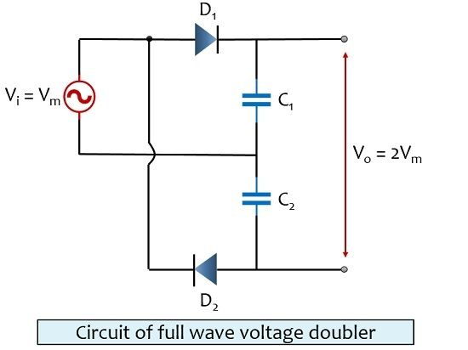
Full Wave Voltage Doubler
The figure below shows the circuit of full wave voltage doubler:

Slide 8
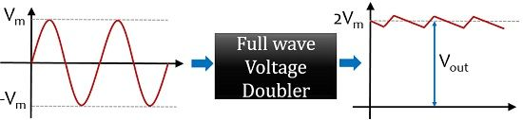
Advantages of Voltage Doubler
It eliminates the use of a high voltage transformer. As it changes a low voltage to high at a low rate.
Voltae multiplication can be greatly increased by cascading such circuits.
Disadvantages of Voltage Doubler
The output present has undesired fluctuations called ripples.
Applications of Voltage Doubler
cathode ray tubes,
x-ray .
radar systems .
laser systems .
oscilloscopes etc.

